Slide 1
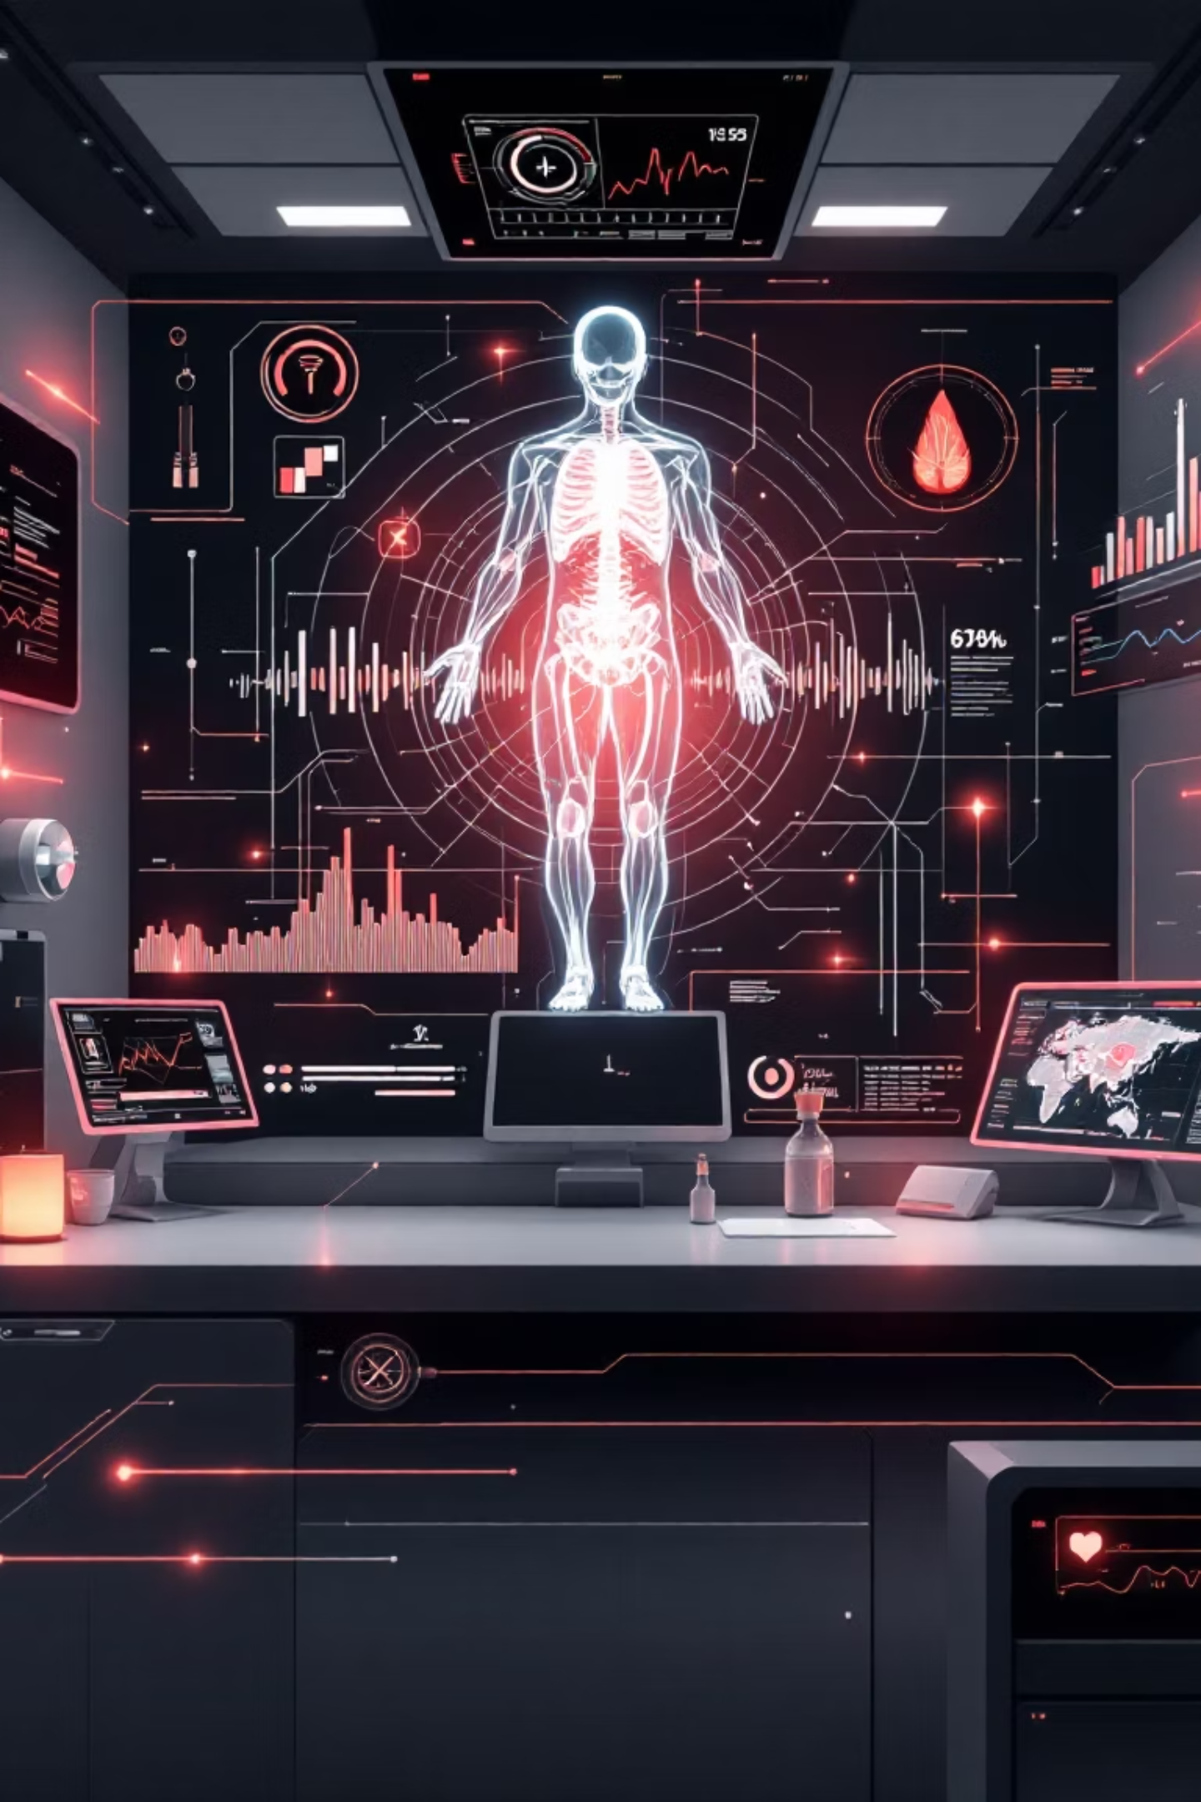
Enhancing Image-Based Disease Detection
Using Just 3 Lab Values (Haemoglobin, WBC, CRP)
Presented By:
Ashutosh Ranjan(22BCE8699)
Divyanshu Raj (22BCE8402)
Supervisor: Dr. Shalini Ramanathan, Assistant Professor (SG1), Department of AI/ML
Institution: SCOPE, VIT-AP University, Amaravathi

Slide 2
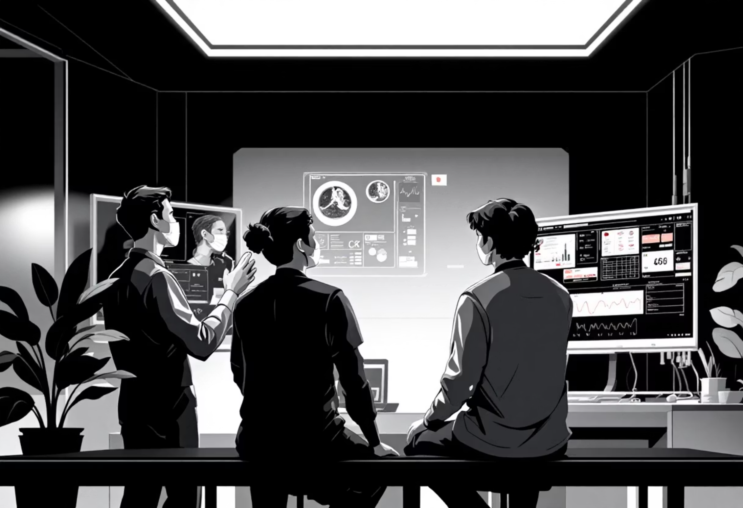
Bridging the Diagnostic Gap
Traditional medical diagnostics have long relied on the separate analysis of imaging modalities, such as CT and MRI scans, and clinical logs. While Computer-Aided Diagnosis (CAD) has seen significant advancements, its focus has predominantly been on image-only deep learning approaches.
This project innovatively bridges this gap by fusing CT scans with three critical lab values: Haemoglobin (Hb), White Blood Cell count (WBC), and C-reactive protein (CRP), creating a more holistic diagnostic tool.

Slide 3




Addressing Common Diagnostic Challenges
Visual Ambiguity
High False Positives
Many distinct conditions, such as pneumonia and inflammation, often present with similar visual patterns on CT scans, leading to diagnostic uncertainty.
Image-only models frequently struggle to differentiate active infections from residual scarring, resulting in an elevated rate of false positive diagnoses.
Resource Constraints
Missing Context
Developing complex multimodal models typically demands vast Electronic Health Records (EHR) datasets, which are not always readily available.
A seemingly 'normal' imaging scan can mask a severe systemic infection that is only detectable through specific blood markers.

Slide 4





Conventional Approaches to Medical Image Analysis
Standard CNN Architectures
Focus on Segmentation
Many systems utilise well-established Convolutional Neural Network architectures like ResNet, VGG, and DenseNet, often pre-trained on large datasets such as ImageNet.
U-Net based methodologies are widely employed to precisely localise lesions and abnormalities within medical images.
Transfer Learning
Reliance on High-Resolution
The practice of fine-tuning pre-trained vision models on domain-specific medical datasets to enhance their performance.
Such methods often necessitate high-quality, contrast-enhanced imaging for optimal accuracy and diagnostic efficacy.

Slide 5

Limitations of Existing Solutions
Sensitivity to Noise: Artefacts present in lower-quality scans frequently lead to misclassification, reducing diagnostic reliability.
Lack of Systemic Insight: Current models often fail to detect non-structural pathologies, such as early-stage sepsis, which require systemic markers.
Data Hunger: These approaches typically demand thousands of exhaustively annotated images to achieve adequate generalisation.
Black Box Decision Making: Relying solely on visual features often precludes a clear clinical explanation for diagnostic conclusions.

Slide 6
Our Novel Multimodal Fusion Approach
Constraint-Driven Multimodal Fusion
Parallel Feature Extraction
Late Concatenation Fusion
An innovative integration of 2D CT slices with precisely three key lab values: Hb, WBC, and CRP.
Utilising a Convolutional Neural Network (CNN) for image processing and a Multi-Layer Perceptron (MLP) for laboratory data.
Feature vectors are combined at a later stage, just prior to the final classification, optimising information flow.
4-Class Classification
Lightweight Design
The model categorises diagnoses into Normal, Tumour, Infection, and Inflammatory, offering nuanced results.
Optimised for efficient deployment, particularly in environments with limited computational resources.

Slide 7

Methodology: The Fusion Flow
Classifier
CT Image Input
FC layers + Softmax
224x224x3 image
Fusion Layer
Multimodal Fusion Pipeline
ResNet18 Backbone
Concatenate to 544 features
Extracts 512 features
Dense MLP
Clinical Vector Input
Outputs 32 features
CRP, WBC, Hb values
This diagram illustrates the parallel processing and subsequent fusion of imaging and clinical data, culminating in a probabilistic four-class diagnosis.

Slide 8
Dataset Composition
Our balanced 4-Class dataset comprises approximately 3000 carefully curated samples:
Tumour: Sourced from LIDC-IDRI, specifically lung nodules.
Normal: Also from LIDC-IDRI, using non-nodule CT slices.
Infection: Utilising the SARS-CoV-2 CT Dataset (Kaggle) as a proxy for infectious pathologies.
Inflammatory: Employing the Kidney Stone CT Dataset (Kaggle) as a proxy for non-infectious inflammatory conditions.
Laboratory Values: Synthetically generated based on clinical reference ranges, guided by NHANES priors, ensuring realistic distribution.

Slide 9
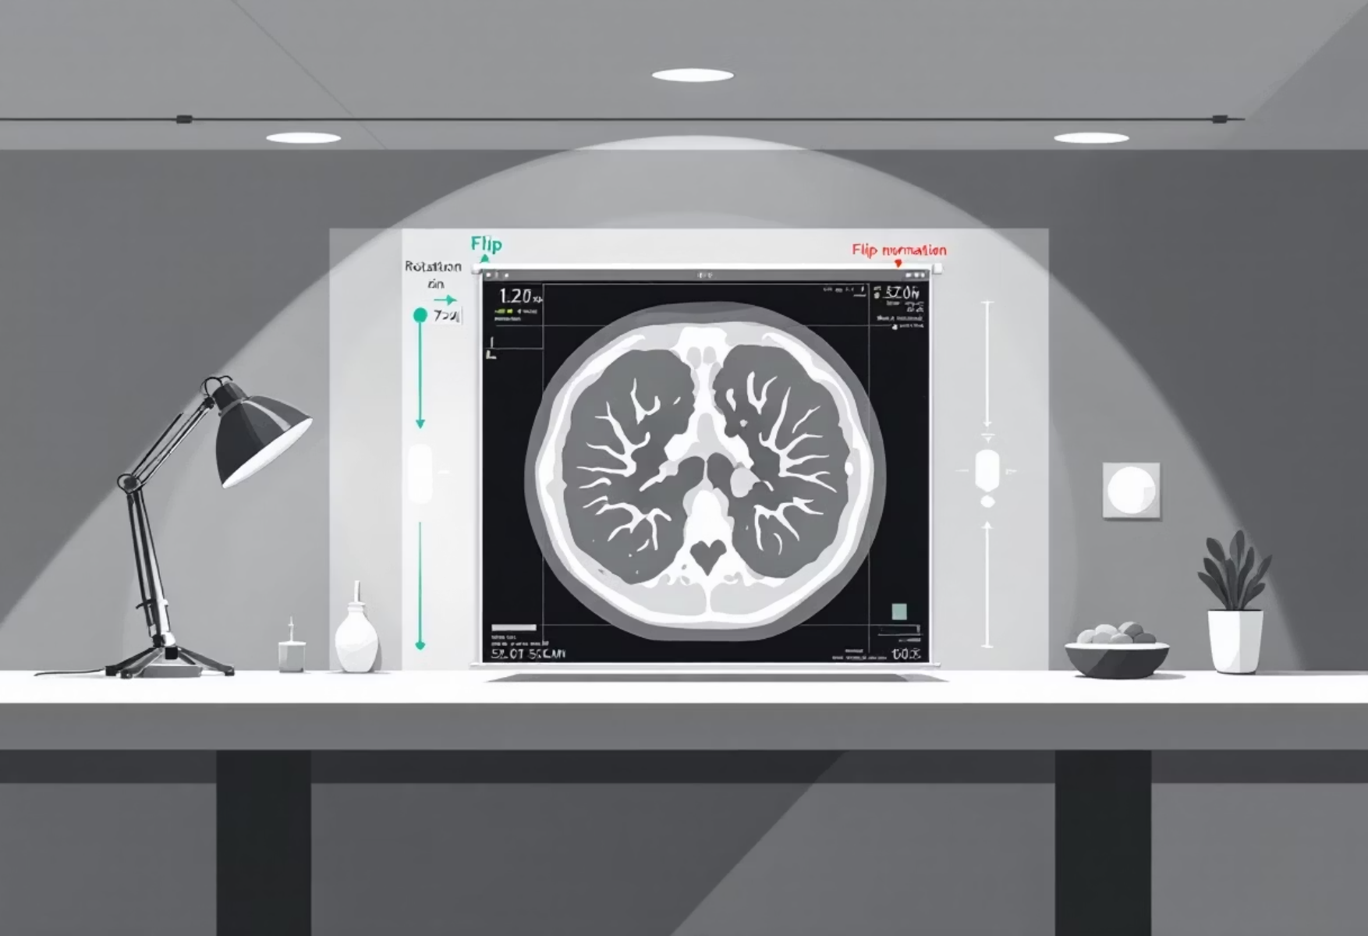
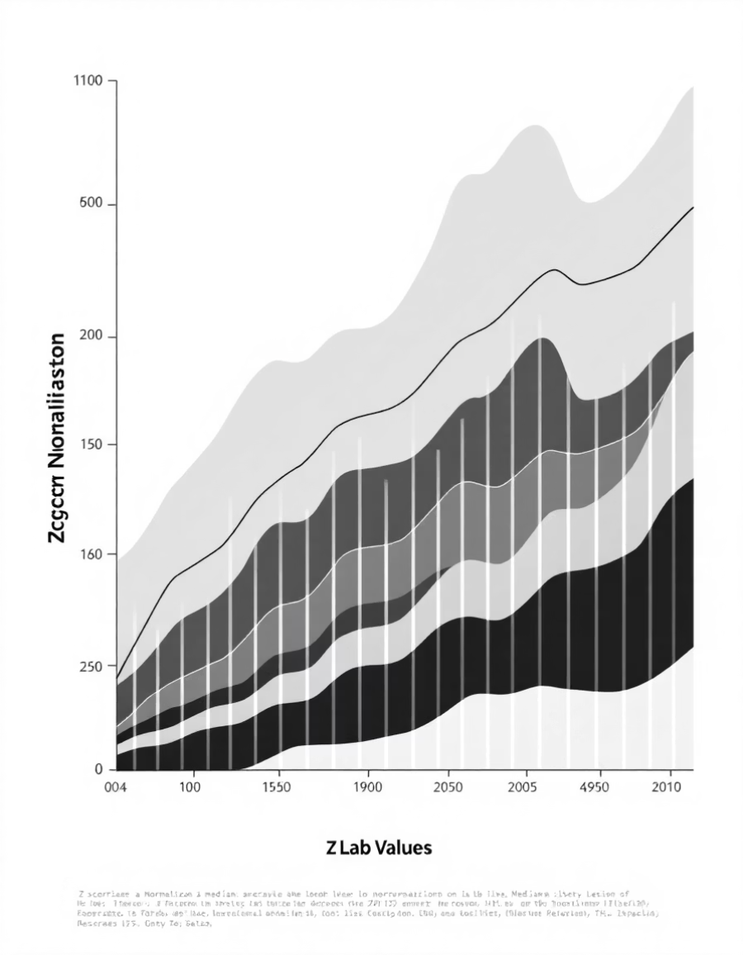
Preprocessing Techniques
Lab Pipeline
Image Pipeline
Standardisation: Z-score normalisation, calculated as (Value - Mean) / Std Dev, is applied to all lab values.
Missing Data Handling: Where applicable, missing lab data is imputed using class-based medians to maintain dataset integrity.
Resizing: All images are uniformly resized to 224 \times 224 pixels, aligning with standard ResNet input dimensions.
Normalisation: Mean and standard deviation scaling is applied, using ImageNet statistics, to standardise pixel values.
Augmentation: Random rotations and flips are implemented to enhance model generalisation and mitigate overfitting.

Slide 10
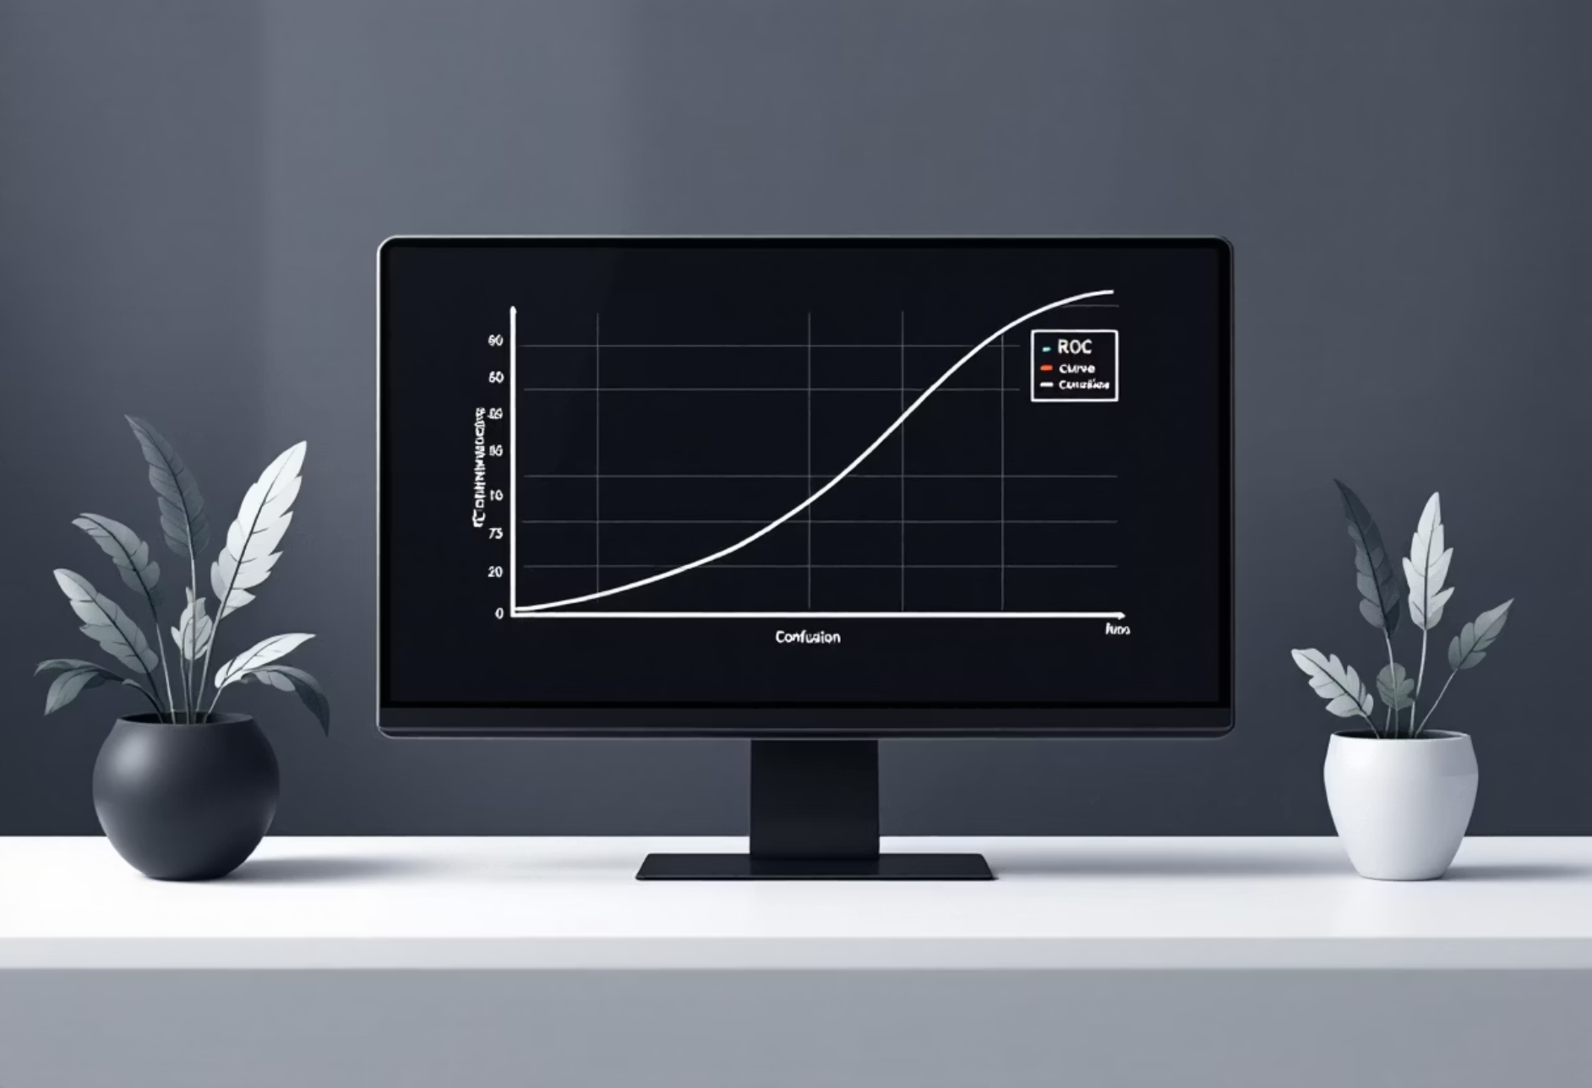
Performance Assessment
Key Metrics for Evaluation
Primary Metric: Accuracy (Overall correctness of predictions).
Class-wise Precision: To effectively minimise False Positives, ensuring confident diagnoses.
Recall (Sensitivity): Crucial for minimising False Negatives, particularly vital in medical AI where missed diagnoses can be critical.
F1-Score: A harmonic mean that provides a balanced evaluation of both precision and recall.
Visualisation Tools
Confusion Matrix: Provides a detailed breakdown of true positives, true negatives, false positives, and false negatives.
ROC-AUC Curves: Illustrates the model's diagnostic ability across various threshold settings.

Slide 11
Comparison Methods
Baseline 1: Image-Only CNN (ResNet18)
Trained exclusively on CT slices without accessing any laboratory data.
Acts as a control to measure the standalone diagnostic power of visual features.
Baseline 2: Lab-Only MLP
A Multi-Layer Perceptron trained solely on the 3 lab values (Hb, WBC, CRP).
Determines if clinical markers alone are sufficient for classification.
Proposed Fusion Model (Multimodal)
Combines the extracted image features and clinical vectors.
Expected to outperform both baselines by reducing false positives in visually ambiguous cases.
Standard Benchmark Comparison
Comparison against legacy architectures like LeNet-5 and AlexNet to demonstrate the efficiency of the modern ResNet backbone.

Slide 12
Hardware & Software Requirements
Software Stack
Development Environment (IDE): Visual Studio Code (VS Code).
Programming Language: Python 3.9+.
Deep Learning Framework: PyTorch (for model training).
Libraries: OpenCV (Image Processing), Pandas (Data Handling), Scikit-learn (Metrics).
Hardware Specifications (Local Workstation)
GPU: NVIDIA GeForce RTX 3060 (6GB VRAM) – Utilized for accelerated model training.
Processor: AMD Ryzen 7 – Handles data preprocessing and augmentation tasks.
Memory: 16GB RAM – Sufficient for batch loading of CT scans.
Storage: 512GB SSD – Ensures high-speed data retrieval during training epochs.

Slide 13
Conclusion
Successfully Integrated Multimodal Data: The project demonstrates a working framework that fuses 2D CT imaging with minimal clinical data (Hb, WBC, CRP).
Enhanced Diagnostic Accuracy: By adding physiological context, the model addresses the critical limitation of "visual ambiguity" in standard CAD systems.
Low-Resource Optimization: The "Constraint-Driven" approach ensures the solution remains deployable in rural or resource-limited healthcare centers.
Future Scope: The architecture is designed to be extensible, allowing for future integration of Real-Time EHR data streams or MRI modalities.

Slide 14
References
(Shen, Dinggang, Guorong Wu, and Heung-Il Suk. "Deep learning in medical image analysis." Annual Review of Biomedical Engineering 19.1 (2017): 221-248.
Armato III, Samuel G., et al. "The lung image database consortium (LIDC) and image database resource initiative (IDRI): a completed reference database of lung nodules on CT scans." Medical Physics 38.2 (2011): 915-931.
He, Kaiming, et al. "Deep residual learning for image recognition." Proceedings of the IEEE Conference on Computer Vision and Pattern Recognition (CVPR). 2016.
Gunraj, H., Wang, L., and Wong, A. "COVIDNet-CT: A Tailored Deep Convolutional Neural Network Design for Detection of COVID-19 Cases from Chest CT Images." Frontiers in Medicine 7 (2020): 608.
Kaggle Datasets: "SARS-CoV-2 CT-Scan Dataset" and "CT Kidney Dataset (Normal-Cyst-Tumor-Stone).”

